Slide 1
Jeopardy
Variables
Errors
Loops
Classes and
Objects
Program
Structure
$100
$100
$100
$100
$100
$200
$200
$200
$200
$200
$300
$300
$300
$300
$300
$400
$400
$400
$400
$400
$500
$500
$500
$500
$500
Final Jeopardy

Slide 2
Variables - $100
What are variables used for (in Java)?
To store information

Slide 3
Variables - $200
Before a variable can be used, it has to be…
Declared OR Initialized

Slide 4
Variables - $300
Name four data types that variables can have.
ANY 4 OF THE FOLLOWING:
  int -String -double -boolean
  char -float

Slide 5
Variables - $400
What will be printed by the following code?
int n1 = 25;
int n2 = 5;
String tacos = “burritos”;
System.out.println(n1 + n2 + “ fish ” + tacos);
30 fish burritos

Slide 6
Variables - $500
Why does the compiler need to know the data type of a variable?
To know how much memory space to save for the variable

Slide 7
Errors - $100
What kind of error can be caused by a misspelled word, and will cause compiler errors?
Syntax error

Slide 8
Errors - $200
Trying to take the square root of a negative number will cause what kind of error?
Runtime error

Slide 9
Errors - $300
What is the error in the code below?
system.out.print(“Bazinga.”);
“system” should be capitalized

Slide 10
Errors - $400
When you see a “Reached end of file while parsing” error message, what does it usually mean you need to add?
A closing curly brace

Slide 11
Errors - $500
Why are logical errors harder to find than syntax or runtime errors?
The program will still compile and run—no error messages
(but it won’t do what you want it to do)

Slide 12
Loops - $100
Name two types of Java loops.
Any two:
  While loop
  Do-while loop
  For loop

Slide 13
Loops - $200
What is the difference between a while loop and a do-while loop?
A do-while loop will always run at least once.

Slide 14
Loops - $300
Why would you use a for loop instead of a while loop?
You want your loop to run a specific number of times

Slide 15
Loops - $400
Why will the following code run forever (an infinite loop)?
int a = 20;
while (a != 0) {
System.out.println(“La la la”);
}
The loop only ends when a is 0, but a never changes.

Slide 16
Loops - $500
What does the following code do?
for (int a = 10; a >= 0; a--) {
System.out.println(a);
}
Counts down from 10 to 0

Slide 17
Classes and Objects - $100
What is the access level of an instance attribute?
private

Slide 18
Classes and Objects - $200
What is a class attribute?
A class attribute is an attribute that is static

Slide 19
Classes and Objects - $300
By what name do you use the object below
Superhero CaptainObvious = new Superhero();
CaptainObvious

Slide 20
Classes and Objects - $400
In the method below, the part in the parentheses is used to tell the method what kind of data to expect.
public int AddThree(int n1, int n2, int n3)
What is this part called?
argument list

Slide 21
Classes and Objects - $500
Every class has a method that sets up new objects and may assign values to variables. What is this method called?
Constructor

Slide 22
Program Structure - $100
Name 2 things every file has to have
Class name, main method, curly braces (other answers possible)

Slide 23
Program Structure - $200
If you use a variable in a condition of the loop- where to you declare it?
At the top

Slide 24
Program Structure - $300
What are the statements called at the very top of a program that tell Java which libraries to use?
Import statements

Slide 25
Program Structure - $400
What are if statements used for in a Java program?
To make decisions

Slide 26
Program Structure - $500
Where is the missing curly brace?
public class Thing {
public static void main(Sting [] args) {
int a;
for (a = 0; a < 5; a++)
System.out.println(a);
}
}
}

Slide 27
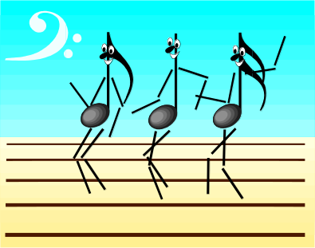
Final Jeopardy
Write 2 lines of code:
FIRST LINE: Declares a Scanner object called scan
SECOND LINE: Uses scan to read in an integer from the keyboard
Scanner scan = new Scanner(System.in);
scan.nextInt();

